Slide 1
Control Valves
Lec-13
Instrumentation and Process Control – ChE-323

Slide 2
Final Control Element
Final control elements can be different for different applications
  Variable Speed Pumps
  Power Controller
  Pneumatic control valve – Most Common
    Regulates flow of fluid

Slide 3
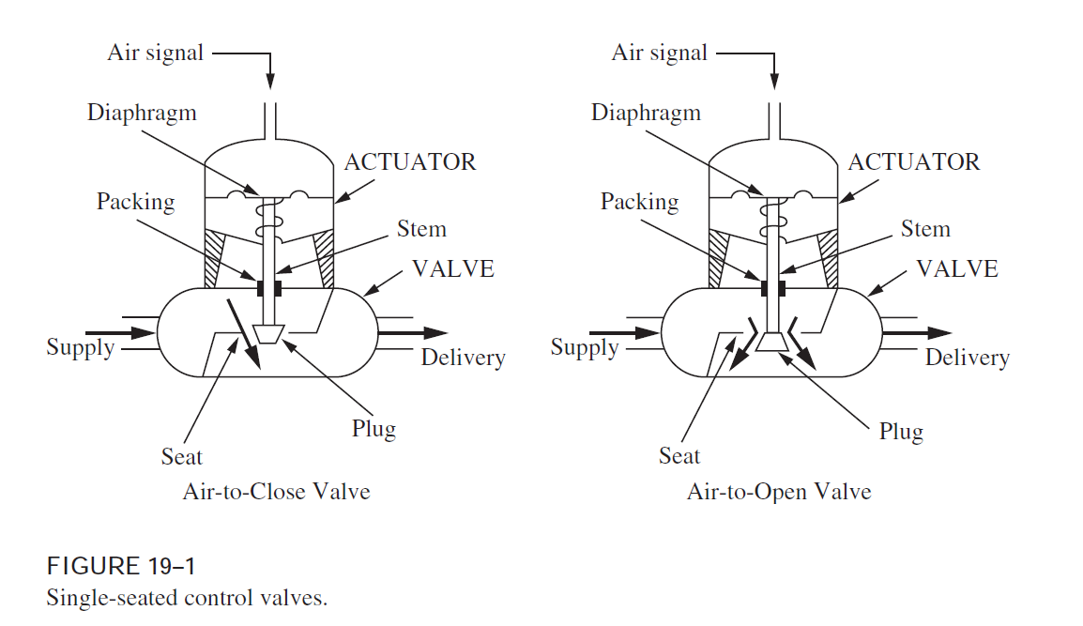
Control Valve Construction

Slide 4
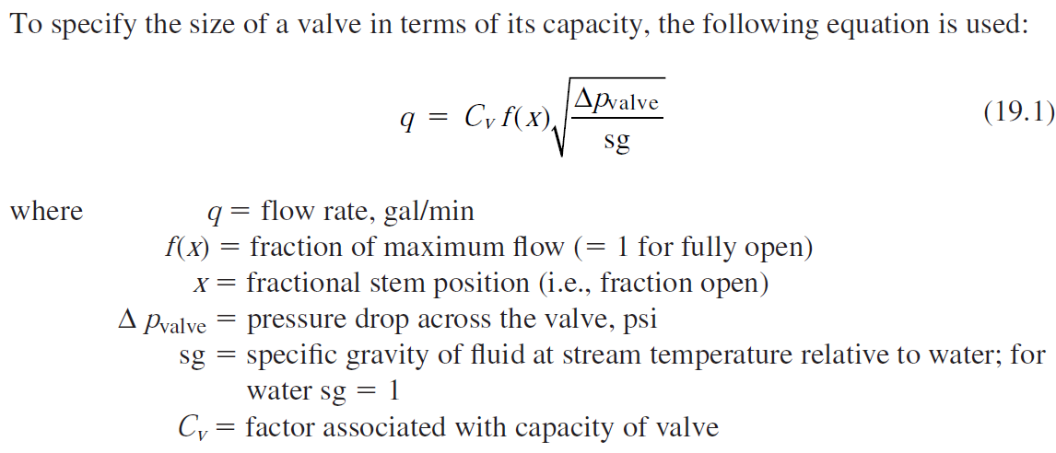
Valve Sizing

Slide 5
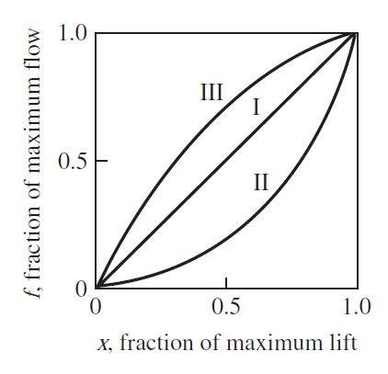
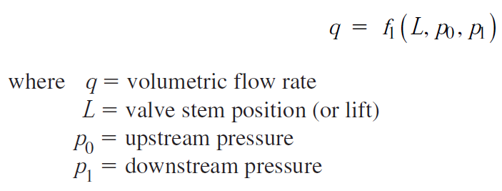
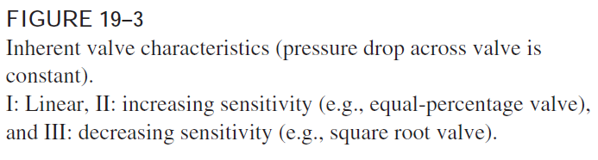
Valve Characteristics
The relation between the flow through the valve and the valve stem position (or lift) is called the valve characteristic.

Slide 6
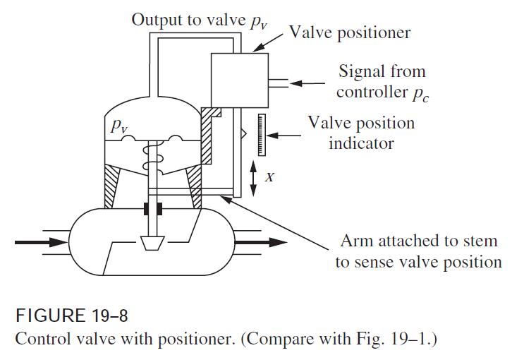
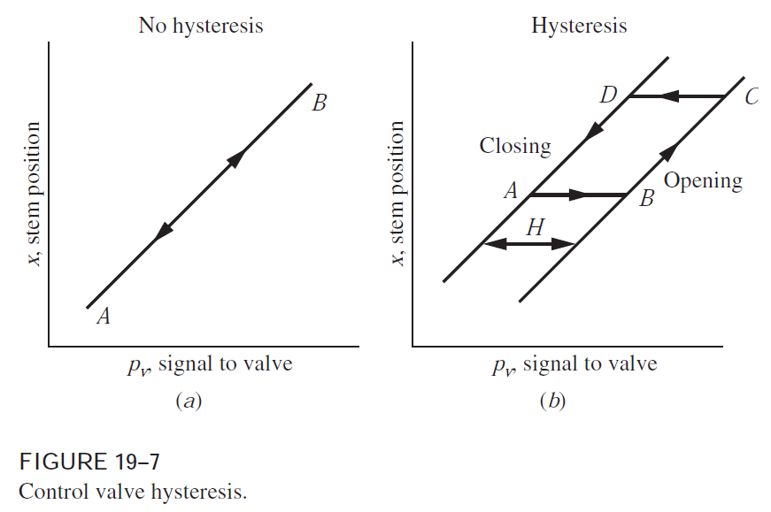
Valve Positioner
The friction in the packing and guiding surfaces of a control valve often causes a control valve to exhibit hysteresis
Positioner acts as a high gain proportional controller

